Slide 1
Reliable Deployments with Kubernetes and Istio
Estu Fardani
Implement blue/green deployments and canary roll outs
estu@opensuse.id
tuanpembual.wordpress.com
@tuanpembual

Slide 2
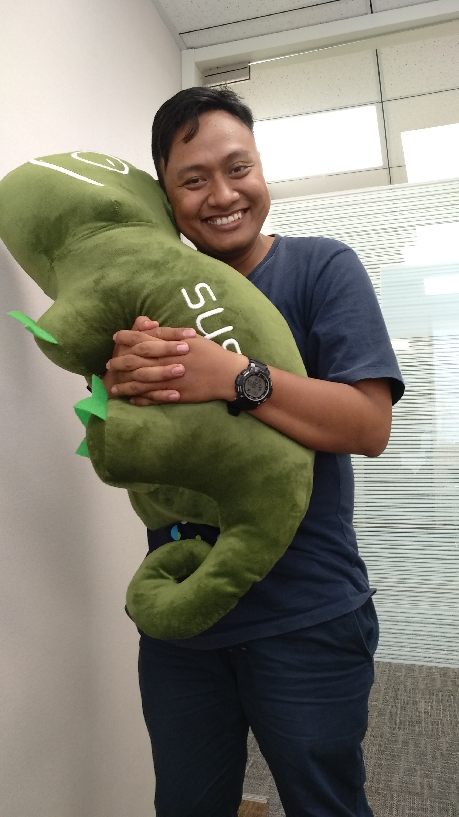
About Me
Estu Fardani
@tuanpembual
DevOps Consultant
Gecko Lover

Slide 3
About this workshop
git clone github.com/tuanpembual/bali

Slide 4
What is Istio
Istio is an open source independent service mesh that provides the fundamentals you need to successfully run a distributed microservice architecture.
Istio lets you connect, secure, control, and observe services.

Slide 5
What is a service mesh?
The term service mesh is used to describe the network of microservices that make up such applications and the interactions between them

Slide 6
Why use Istio?
Istio makes it easy to create a network of deployed services with load balancing, service-to-service authentication, monitoring, and more, with few or no code changes in service code

Slide 7
Blue-Green Deployment
The blue-green deployment approach does this by ensuring you have two production environments, as identical as possible. At any time one of them, let's say blue for the example, is live.

Slide 8
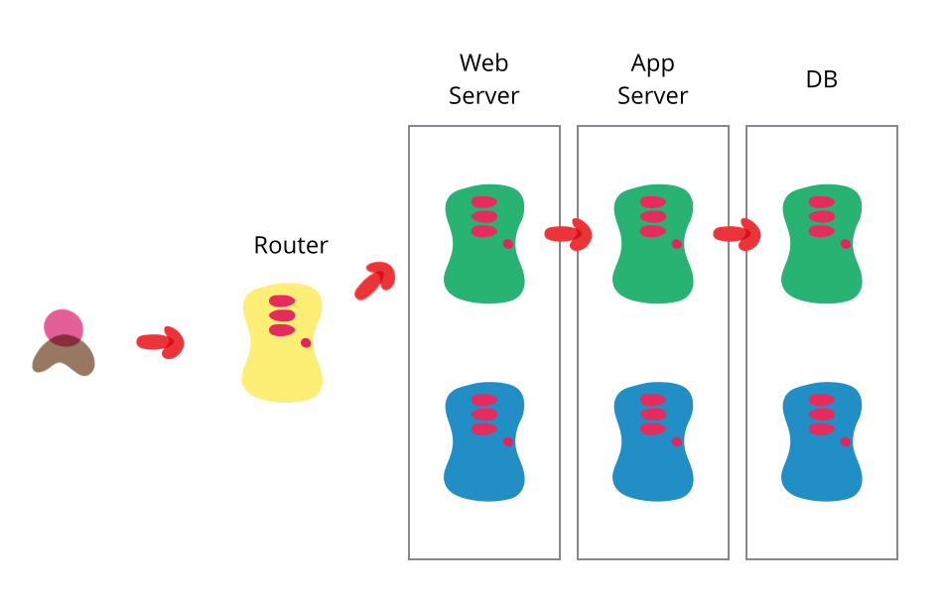
https://martinfowler.com/bliki/BlueGreenDeployment.html

Slide 9
Canary Release
Canary release is a technique to reduce the risk of introducing a new software version in production by slowly rolling out the change to a small subset of users before rolling it out to the entire infrastructure and making it available to everybody.

Slide 10
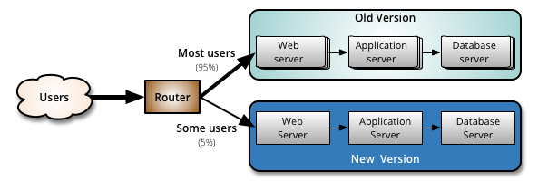
Canary Release
https://martinfowler.com/bliki/CanaryRelease.html

Slide 11
Starting Point
Familiar with:
Docker
k8s/minikube

Slide 12
Go to Labs
We will create kubernetes cluser using minikube

Slide 13
Go to Labs
We will create kubernetes cluser using minikube
Create vm on local or cloud(vagrant, digital ocean, aws)

Slide 14
Go to Labs
Install tools:
Docker without sudo
Kubectl
Minikube
Security group
Gist.

Slide 15
On VM
$ docker version
$ kubectl version
$ minikube version

Slide 16
Go to Labs
Warming up:
$ minikube start –vm-driver=none
$ kubectl run hello-minikube --image=gcr.io/google_containers/echoserver:1.4 --port=8080
$ kubectl expose deployment hello-minikube --type=NodePort
$ kubectl get services
$ kubectl delete services hello-minikube
$ kubectl delete deployment hello-minikube

Slide 17
Go to Labs (2)
$ curl -L https://git.io/getLatestIstio | ISTIO_VERSION=1.3.0 sh -
$ cd istio-1.3.0
$ for i in install/kubernetes/helm/istio-init/files/crd*yaml; do kubectl apply -f $i; done

Slide 18
Go to Labs (3)
$ vim install/kubernetes/istio-demo.yaml
line 17647
```
apiVersion: v1
kind: Service
metadata:
name: istio-ingressgateway
namespace: istio-system
annotations:
labels:
chart: gateways
heritage: Tiller
release: istio
app: istio-ingressgateway
istio: ingressgateway
spec:
```
save n exit

Slide 19
Go to Labs (3)
$ kubectl apply -f install/kubernetes/istio-demo.yaml

Slide 20
Testing deploy 2 version apps
$ vim my-app.yaml
$ kubectl apply -f my-app.yaml
$ kubectl get pods
$ kubectl get svc

Slide 21
Listen Apps
Open two console:
$ kubectl port-forward --address 0.0.0.0 deployment/myapp-v1 8080:80
$ kubectl port-forward --address 0.0.0.0 deployment/myapp-v2 8081:80

Slide 22
Create Gateway
$ vim app-gateway.yaml
$ kubectl apply -f app-gateway.yaml
# edit, save and update
$ kubectl replace -f app-gateway.yaml

Slide 23
Testing Load
Custom load value
```
- destination:
host: myapp
subset: v1
weight: 100
- destination:
host: myapp
subset: v2
weight: 0

Slide 24
Debug Config
$ ip addr # get local ipaddress
$ while : ;do export GREP_COLOR='1;33';curl -s 172.31.25.31:31380 \
| grep --color=always "V1" ; export GREP_COLOR='1;36';\
curl -s 172.31.25.31:31380 \
| grep --color=always "vNext" ; sleep 1; done

Slide 25
See the magic
### FROM:
* https://www.radishlogic.com/kubernetes/running-minikube-in-aws-ec2-ubuntu/
* https://thenewstack.io/tutorial-blue-green-deployments-with-kubernetes-and-istio/
* https://cheatsheet.dennyzhang.com/cheatsheet-minikube-a4

Slide 26
Conclusion
It is still prove of concept at the simple case.
Production, of course not simple as my demo.
Ping me after this workshop :D

Slide 27
Q&A
?

Slide 28
Closing
Thank you for join my workshop

Slide 29
See you next year!!

